Slide 1
The first ndc-centric microservice architecture for the airline industry.
Presenter: Isaac Reynaldo

Slide 2

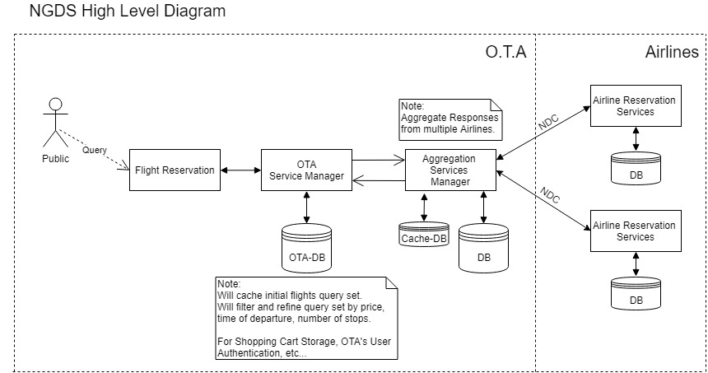
Monolothic architecture
Scaling the application can be difficult.
Requires a long-term commitment to a technology stack.
Continuous deployment is difficult
Harder to learn the bigger the application gets.

Slide 3
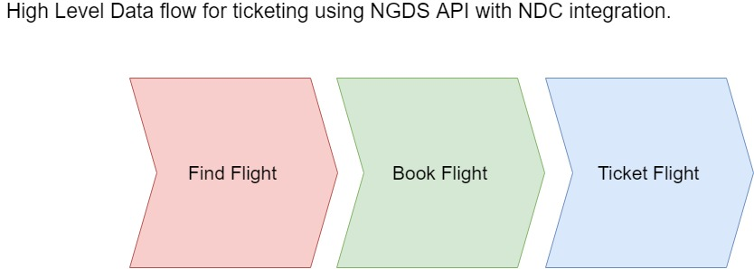
Ticketing using the ndc protocol
Find the flight is done through the AirShoppingRQ/RS.
Booking a flight is done through OrderCreateRQ/OrderViewRS
Then Ticket Flight is done through AirDocIssueRQ/OrderViewRS

Slide 4

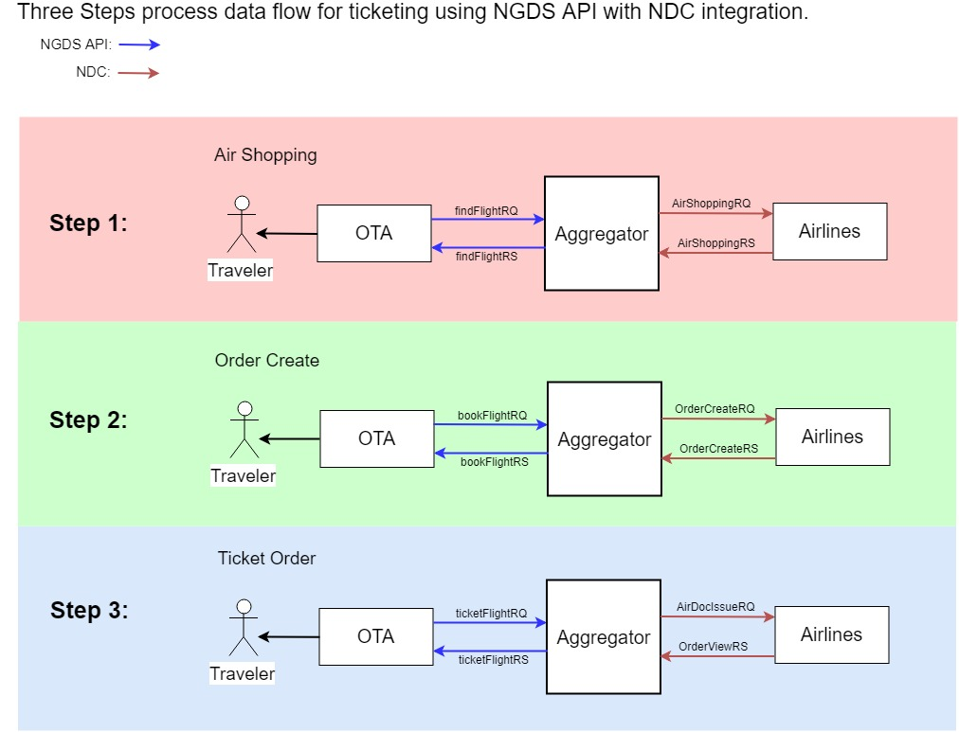
PROBLEM!!!
TOO MUCH STRESS TO THE AGGREGATOR

Slide 5
SOLUTION

Slide 6
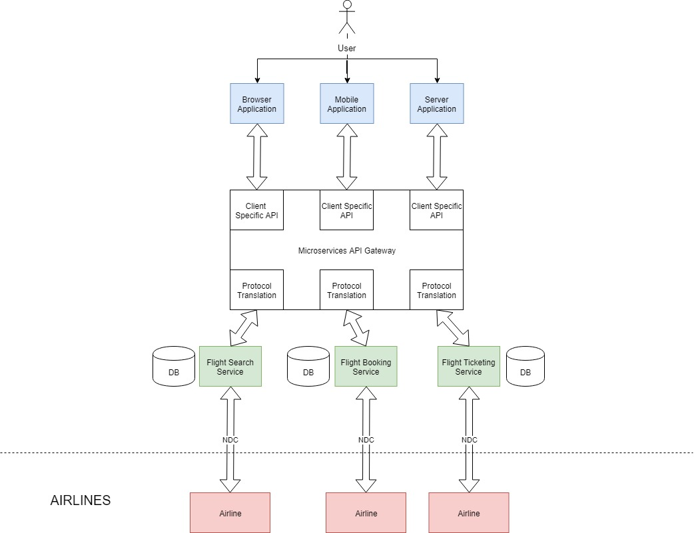
Microservice architecture
Application can be broken down into different services for the different NDC transactions.
Every service can be written independently with different programming languages and architecture.
Scalability!!!
Efficiency!!!

Slide 7
API Gateway
The API Gateway takes all the requests from the clients, then routes them to the appropriate microservice with request routing, composition, and protocol translation. Typically it handles a request by invoking multiple microservices and aggregating the results, to determine the best path. It can translate between web protocols and web-unfriendly protocols that are used internally.
Features:
Load Balancing.
Security.
Routing.
Monitoring and Analytics

Slide 8

Kong is a scalable, open source API Layer (also known as an API Gateway, or API Middleware). Kong runs in front of any API and is extended through plugins, which provide extra functionality and services beyond the core platform.

Slide 9
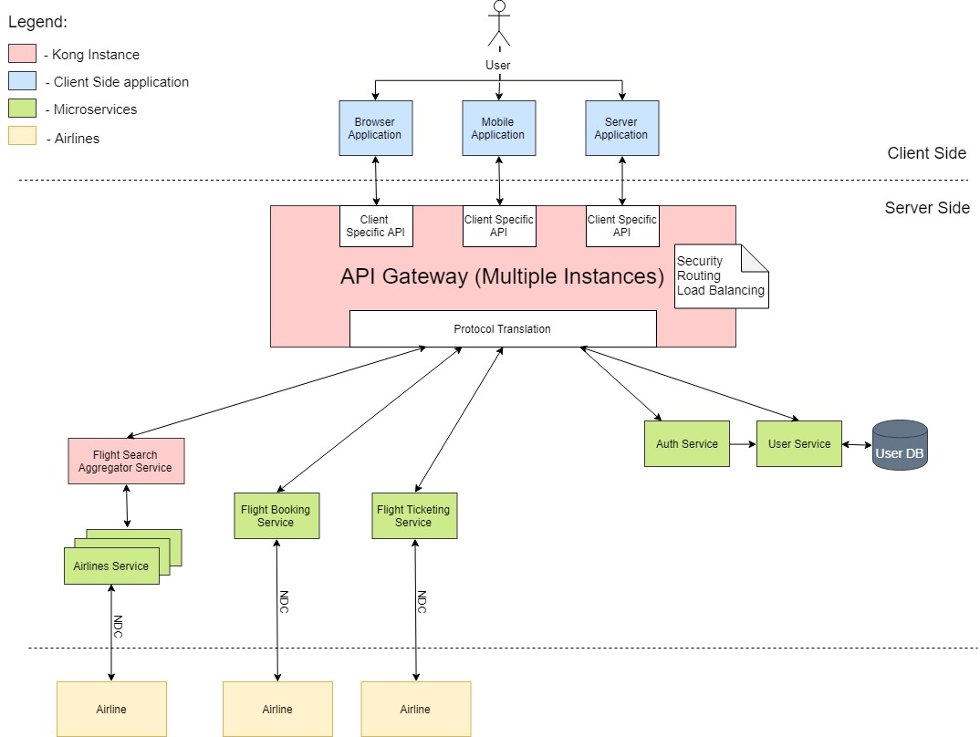
Microservice architecture v2

Slide 10
Service mesh
Making usage of Kong’s capabilities for aggregation of microservices.
Every Airline will have it’s own microservice for flight search.

Slide 11
The end

